Slide 1
AI Based Job Application Tracking System
By
S. Bharath Reddy 21AG1A66B2
D.P. Shashank Reddy 21AG1A6679
D. Vigneshwar 21AG1A6678
Guide Project coordinator HOD-CSE(AI&ML)
Dr. S. Kavitha Mrs. J. Bhargavi Dr. S. Kavitha

Slide 2
ABSTRACT:
This study presents a AI powered job application tracking system focused on promoting fair and unbiased candidate assessment. Built with ReactJS and Flask, the system leverages AI Ethics tools such as TensorFlow Fairness Indicators and IBM’s AIF360 to identify and reduce biases in hiring. Fairness metrics help detect potential biases in the application process, while reweighing techniques are applied to ensure that all demographic groups are represented equitably.
In addition, the system performs soft skills analysis, using Hugging Face NLP models to examine candidates' activity descriptions for indicators of interpersonal skills. By integrating these fairness checks with soft skills insights, the system produces a balanced score for each candidate, helping organizations make more inclusive and transparent hiring decisions. This approach addresses bias in recruitment while offering a practical solution for fairer hiring practices.
Keywords: AI Ethics Tools, TensorFlow, AIF360 tool, Hugging Face Model, ReactJS, Flask.

Slide 3
INTRODUCTION:
In today's rapidly evolving job market, organizations are increasingly relying on technology to streamline their hiring processes. However, traditional recruitment methods often suffer from inherent biases, whether conscious or unconscious, which can lead to unfair hiring practices. These biases may stem from various factors, including inconsistencies in evaluation criteria, subjective decision-making, or reliance on limited data points. Such biases undermine the effectiveness of recruitment strategies and prevent companies from selecting the best candidates based on merit.
To address this critical issue, organizations are turning to Artificial Intelligence (AI) and machine learning to bring fairness and transparency to recruitment. AI-driven hiring solutions can systematically analyze large datasets, recognize potential biases in decision-making, and ensure that recruitment decisions are data-driven and objective. Ethical AI tools provide employers with a powerful means to evaluate candidates fairly by detecting inconsistencies in assessments and ensuring a standardized election process. By leveraging AI ethics, natural language processing (NLP), and fairness indicators, this project introduces an AI-powered Job Application Tracking System. The system is designed to create an unbiased hiring environment by incorporating ethical AI principles, soft skills assessment, and equitable candidate ranking mechanisms. Through this innovative approach, companies can improve hiring accuracy, enhance employee satisfaction, and maintain compliance with fair recruitment standards.

Slide 4
LITERATURE SURVEY:
[1] Fairness in AI-Based Hiring: A Review of Bias Mitigation Strategies
This study explores the challenges associated with AI-driven hiring systems, particularly the biases that arise due to imbalanced training data and algorithmic limitations. The authors highlight various bias mitigation techniques, including adversarial debiasing, re-weighting strategies, and fairness-aware learning frameworks. The research emphasizes that while AI can improve hiring processes, it is critical to continuously evaluate and refine fairness metrics to ensure ethical decision-making.
[2] AI in Recruitment: Enhancing Fairness and Efficiency
This paper discusses the role of AI in recruitment, focusing on automated resume screening, skill-based candidate ranking, and behavioral analysis. The study finds that AI can significantly reduce hiring bias when properly implemented but warns that reliance on historical data may perpetuate existing disparities. The research also highlights the importance of transparency in AI based hiring systems and the need for organizations to adopt explainable AI models to justify hiring decisions.

Slide 5
[3] Soft Skills Analysis Using Natural Language Processing
The study examines how NLP techniques can be used to assess candidates' soft skills based on their textual responses. Using transformer-based models, the research demonstrates that AI can effectively analyze communication styles, leadership potential, and teamwork attributes. The findings support the integration of NLP in hiring systems to ensure a more comprehensive evaluation of candidates beyond their technical qualifications.
[4] Fairness Indicators for AI-Powered Hiring Systems
This research presents an evaluation of fairness indicators, such as demographic parity, equal opportunity, and disparate impact, within AI-driven recruitment platforms. The authors propose a framework for assessing and mitigating biases in hiring algorithms, using real-world hiring datasets. The study concludes that AI fairness tools, such as TensorFlow Fairness Indicators and IBM AIF360, play a vital role in maintaining ethical recruitment practices.

Slide 6
EXISTING SYSTEM:
Current AI-driven hiring platforms mainly focus on resume screening and applicant tracking. These systems rely heavily on historical data for training, which often results in biases based on gender, race, or background. Some tools incorporate basic fairness checks, such as gender neutral language, but these measures are often insufficient to mitigate deeper biases, especially regarding the candidate's diverse background or experiences.
Additionally, these platforms typically prioritize technical qualifications, neglecting essential soft skills like communication, leadership, and teamwork, which are crucial for overall job performance. Transparency is another challenge, as many systems operate as "black boxes," leaving recruiters unable to understand how decisions are made. This lack of clarity undermines trust in the system and makes it difficult to address potential biases.

Slide 7
PROPOSED SYSTEM:
The proposed AI-powered Job Application Tracking System aims to overcome these limitations by integrating fairness indicators, NLP-based soft skills analysis, and transparent AI models. Using tools like TensorFlow Fairness Indicators and IBM AIF360, the system ensures unbiased decision-making by assessing and mitigating bias throughout the recruitment process. This approach ensures that all candidates are evaluated based on their merit, irrespective of demographic
factors.
Furthermore, the system employs Natural Language Processing (NLP) to analyze soft skills such as communication, leadership, and adaptability—skills often overlooked by traditional systems. By evaluating both technical and non-technical qualifications, the system offers a balanced scoring mechanism that provides a comprehensive evaluation of candidates.
Unlike traditional platforms, this system offers transparency in its decision-making process. Recruiters can access detailed insights into how rankings and recommendations are made, promoting trust and accountability. By combining fairness, NLP, and transparency, the system addresses the biases present in current hiring systems, improving recruitment outcomes and ensuring a more equitable selection process.

Slide 8
SYSTEM REQUIREMENTS:
Hardware Requirements
Processor: Minimum Intel Core i3 / Recommended Intel Core i5 or AMD Ryzen
RAM: Minimum 4 GB / Recommended 8 GB
Storage: At least 3 GB of free space
Display: Minimum 1366x768 resolution / Recommended Full HD
Internet: Required for cloud-based AI tools and APIs
Software Requirements
Operating System: Windows 10/11, macOS, or Linux (Ubuntu 20.04+)
Programming Languages: Python 3.8+
Frontend: ReactJS, Redux
Backend: Flask, MySQL
AI/ML Libraries: TensorFlow Fairness Indicators, IBM AIF360, Hugging Face Transformers
Code Editor: VS Code

Slide 9
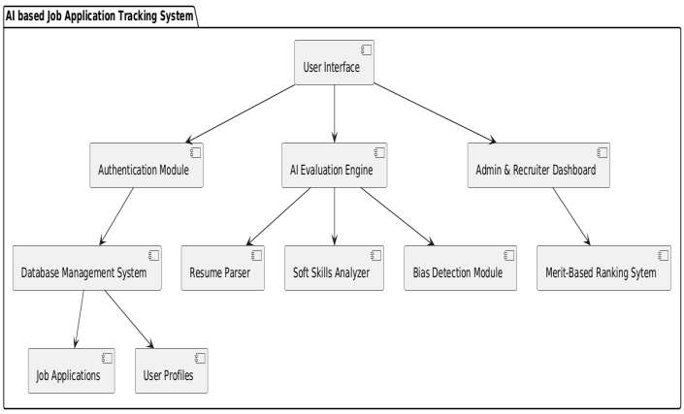
ARCHITECTURE:

Slide 10
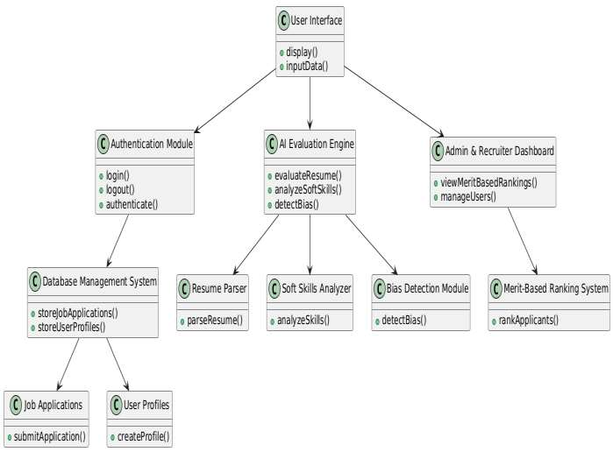
UML DIAGRAMS:
Class Diagram:

Slide 11
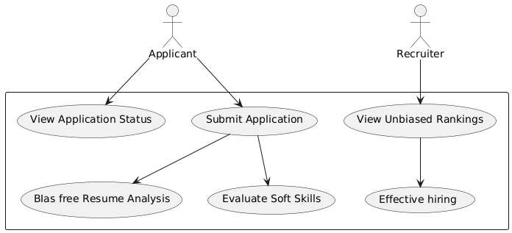
Use Case Diagram:

Slide 12
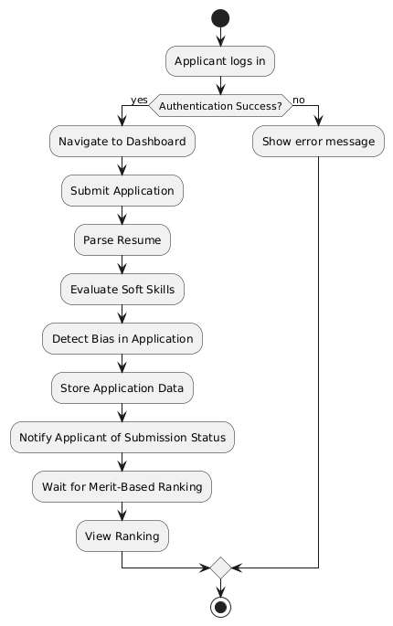
Activity Diagram:

Slide 13
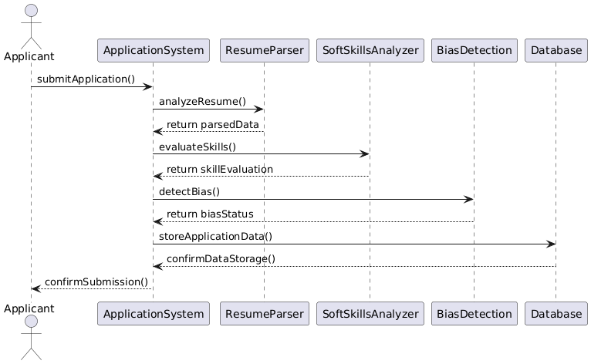
Sequence Diagram:

Slide 14
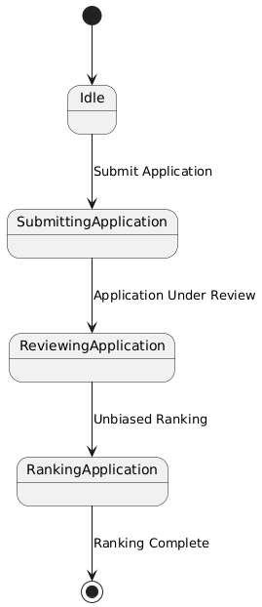
Sequence Diagram:

Slide 15
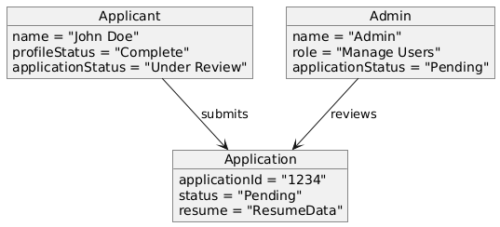
Object Diagram:

Slide 16
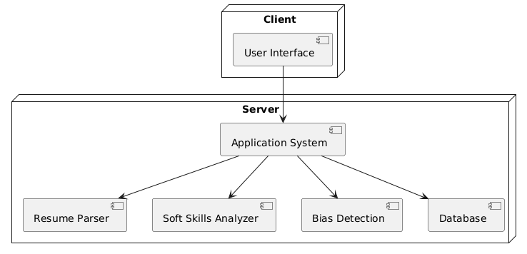
Deployment Diagram:

Slide 17
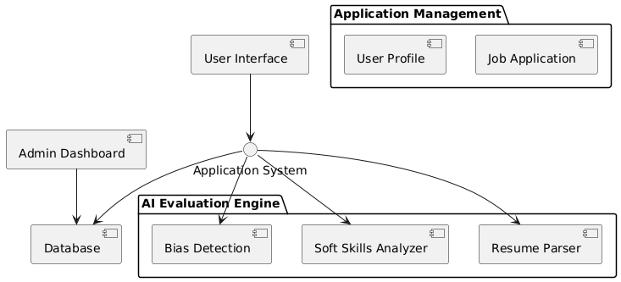
Component Diagram:

Slide 18
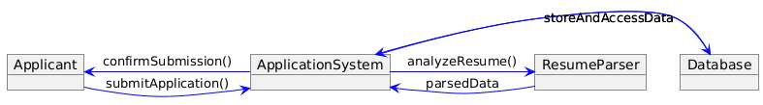
Collaboration Diagram:

Slide 19
ALGORITHM:
1. Resume Parsing:
Input: Resume file (PDF/Word).
Process:
Extract key details such as name, contact information, education, work experience, and skills from the resume.
Use Natural Language Processing (NLP) techniques to structure the data.
Output: Structured data representing applicant's details and skills.
2. Soft Skills:
Input: Applicant's personal details, application data, and any responses in forms or
interview stages.
Process:
Analyze the soft skills based on pre-set criteria (such as communication skills,
teamwork, leadership, etc.).
Evaluate responses (if any) from behavioral questions or past job experience.
Output: Soft skills evaluation score, indicating strengths and weaknesses in key soft
skill areas.

Slide 20
3. Bias Detection:
Input: Application data (resume, personal details, soft skills).
Process:
Detect any biases related to gender, age, ethnicity, or other unfair preferences based on the analysis of historical hiring data.
Use AI/ML algorithms to ensure fairness in evaluating applicants.
Output: Bias detection report (flagging any potential bias in the evaluation process).
4. Merit-Based Ranking and Recommendation:
Input: Resume data, soft skills score, bias detection report.
Process:
Rank applicants based on the quality and relevance of their resumes, along with the evaluation of soft skills.
Ensure that bias has been addressed before final ranking.
Output: Final merit-based ranking of applicants.

Slide 21
THANK YOU

